Slide 1
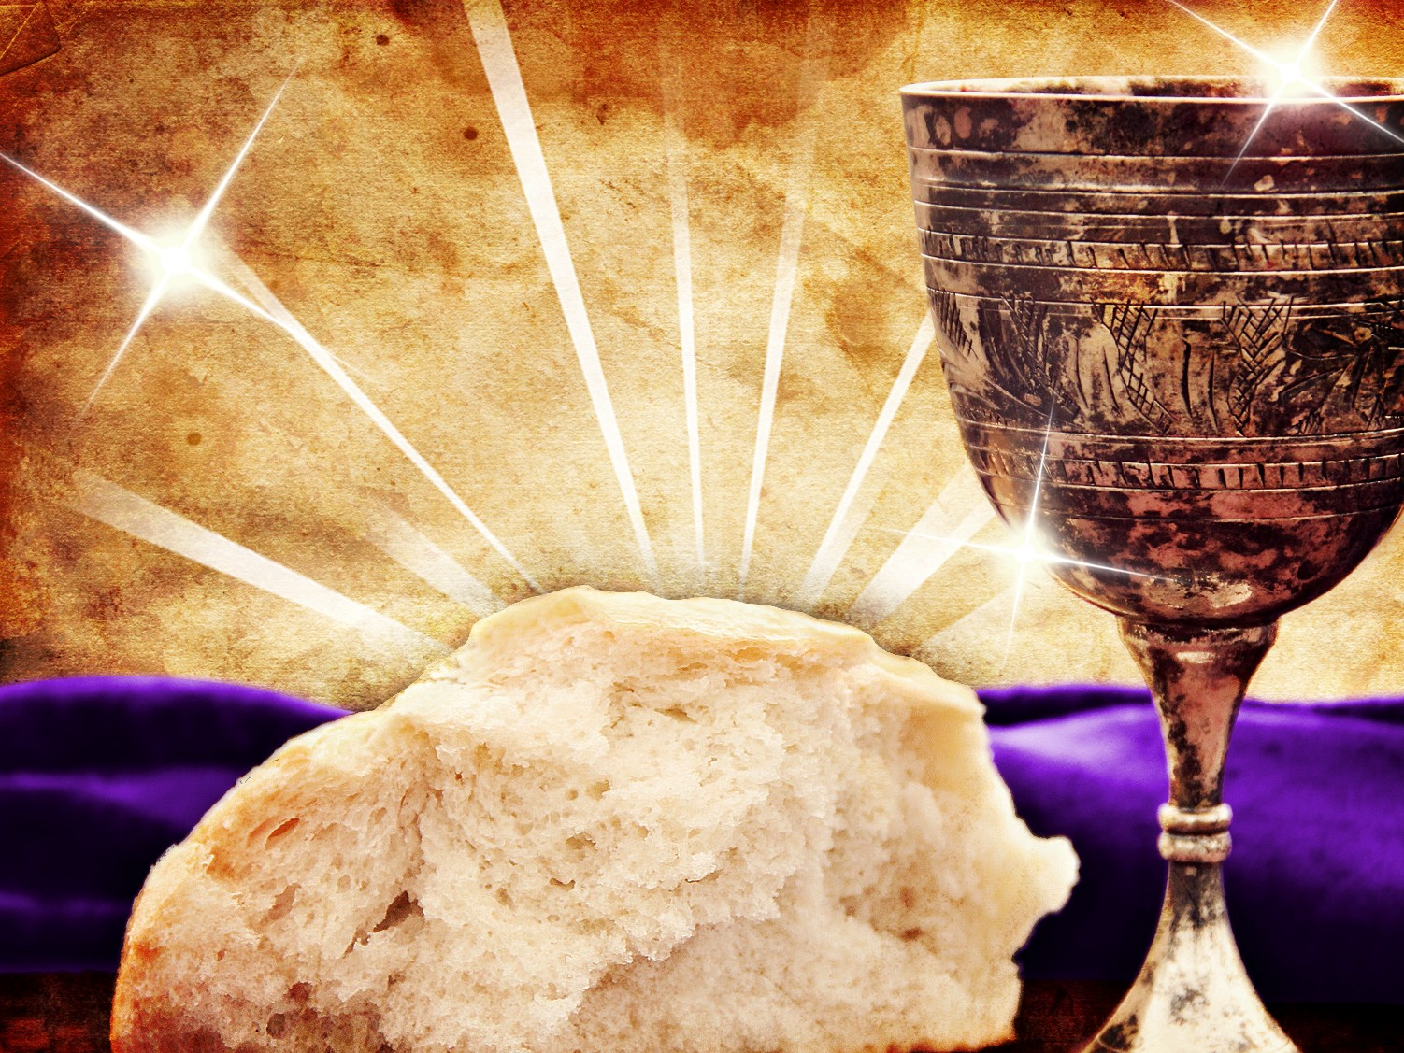
No Ordinary Supper
1 Corinthians 11:17-34
Dr. Rick Griffith • Crossroads International Church Singapore
cicfamily.com & BibleStudyDownloads.org
Notes:
1

Slide 2
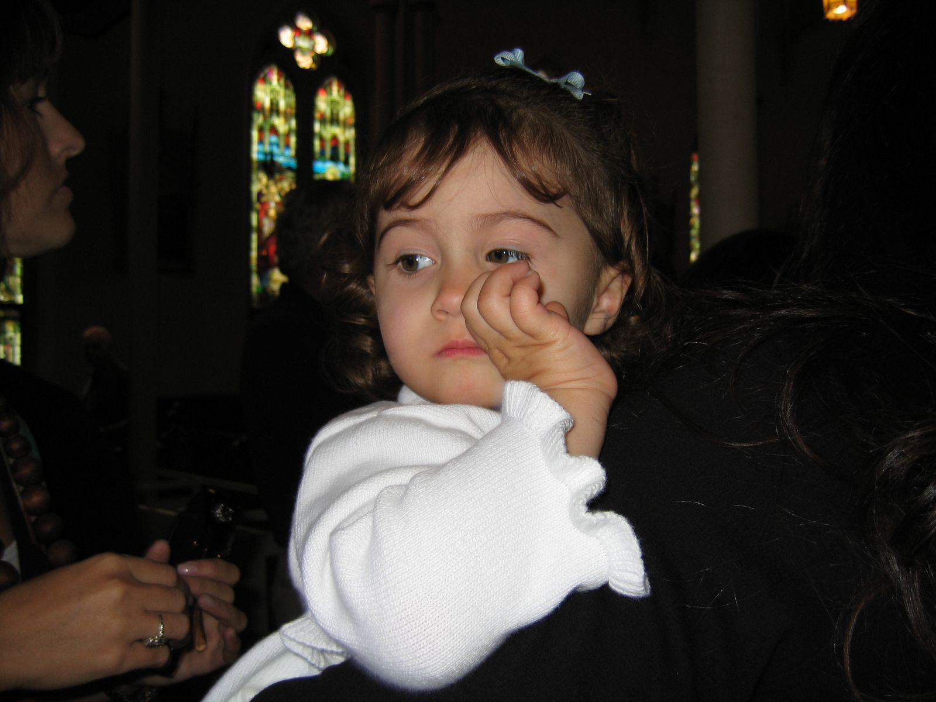
Sarah went to Big Church…

Slide 3
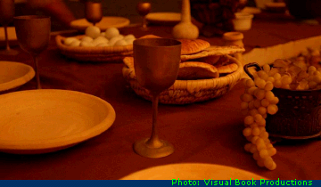
“Do this to remember me”
????
Notes:
3

Slide 4
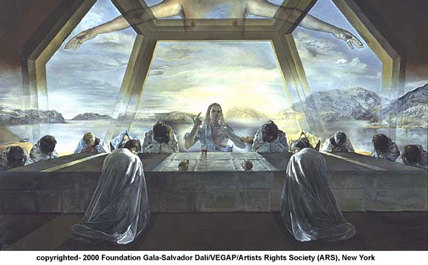
How can you honor God in the Lord's Supper?
Notes:
4

Slide 5
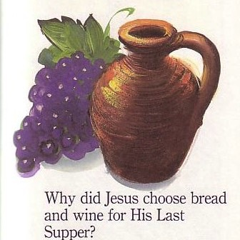
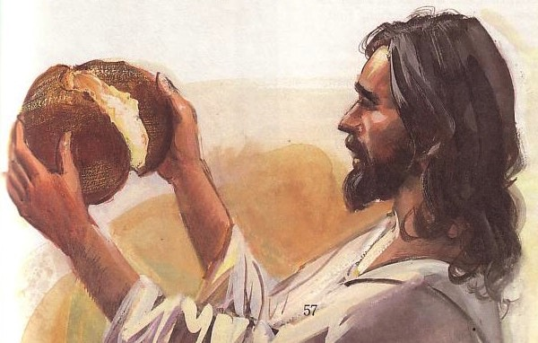
Passover & the Lord's Supper
Four Comparisons

Slide 6
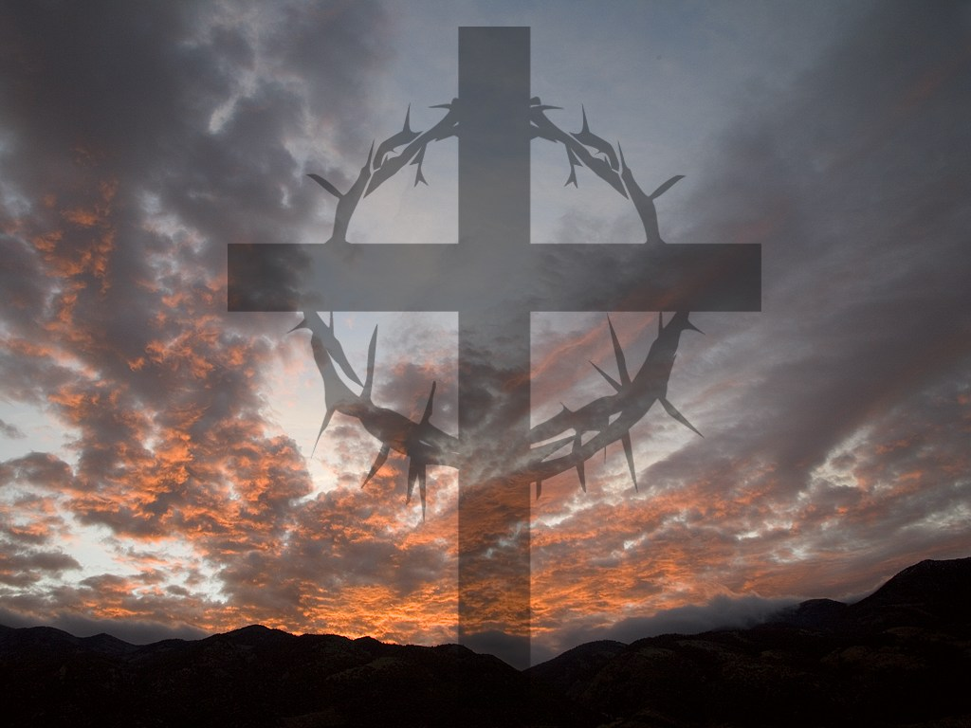
I. Look outward at your relationships with other believers
The Four Directions
outward

Slide 7

The Agape (Love) Feast

Slide 8
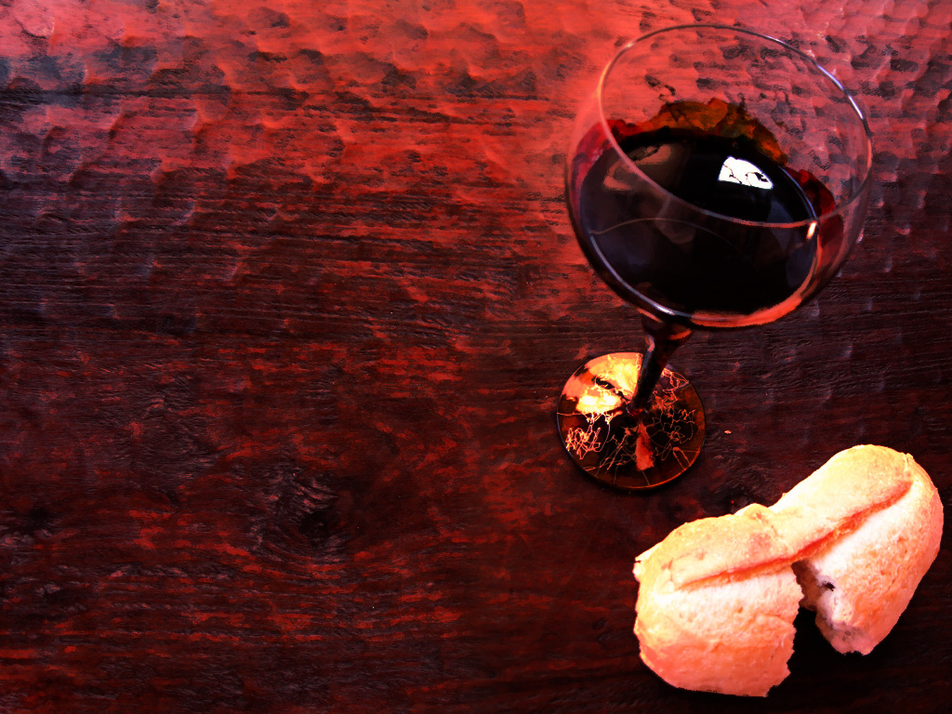
1 Corinthians 11:17-19 (NLT)
But in the following instructions, I cannot praise you. For it sounds as if more harm than good is done when you meet together. ¹⁸First, I hear that there are divisions among you when you meet as a church, and to some extent I believe it. ¹⁹But, of course, there must be divisions among you so that you who have God’s approval will be recognized!
Notes:
8

Slide 9
1 Corinthians 11:20-22 (NLT)
When you meet together, you are not really interested in the Lord’s Supper. ²¹For some of you hurry to eat your own meal without sharing with others. As a result, some go hungry while others get drunk. ²²What? Don’t you have your own homes for eating and drinking? Or do you really want to disgrace God’s church and shame the poor? What am I supposed to say? Do you want me to praise you? Well, I certainly will not praise you for this!
Notes:
9

Slide 10
Black

Slide 11

1 Cor. 10:15-18 (NLT)
¹⁵You are reasonable people. Decide for yourselves if what I am saying is true. ¹⁶When we bless the cup at the Lord's Table, aren't we sharing in the blood of Christ? And when we break the bread, aren't we sharing in the body of Christ? ¹⁷And though we are many, we all eat from one loaf of bread, showing that we are one body. ¹⁸Think about the people of Israel. Weren't they united by eating the sacrifices at the altar?

Slide 12
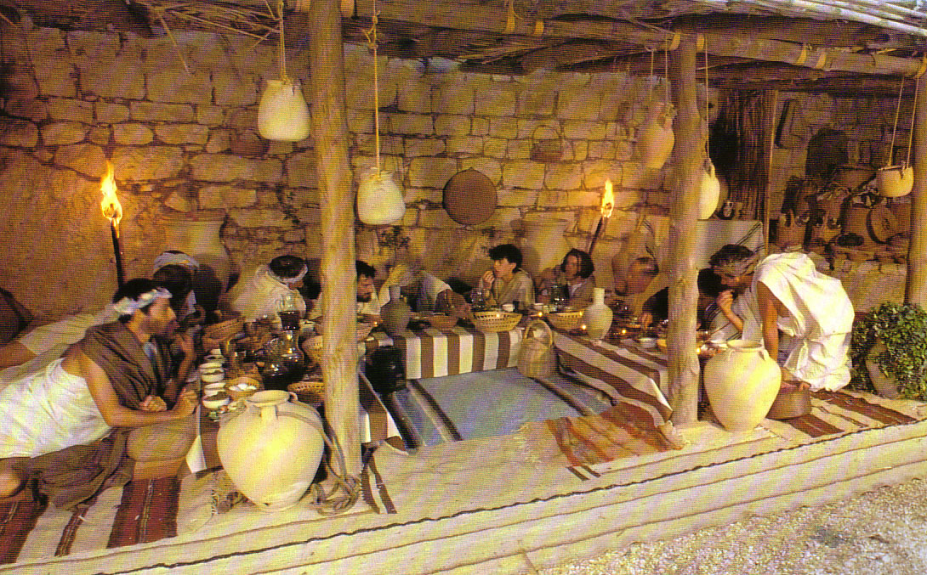
Seating at Jesus' Passover

Slide 13
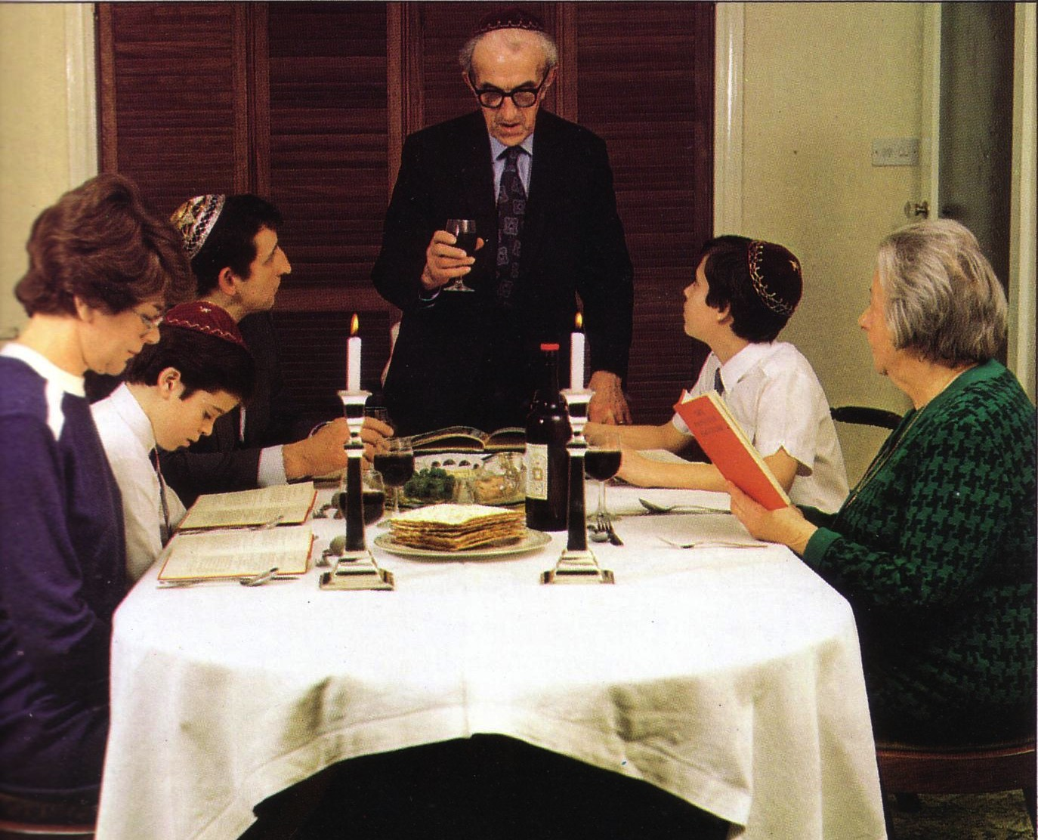
Modern Passover

Slide 14
Black

Slide 15
Matthew 5:23-24
?
"Therefore if you are presenting your offering at the altar, and there remember that your brother has something against you, leave your offering there before the altar and go; first be reconciled to your brother, and then come and present your offering.”

Slide 16
Black

Slide 17
I. Look outward at your relationships with other believers
The Four Directions
outward

Slide 18
II. Look back at Christ's death for you
The Four Directions
outward
back

Slide 19
1 Corinthians 11:23-25
²³For I received from the Lord what I also passed on to you: The Lord Jesus, on the night he was betrayed, took bread, ²⁴and when he had given thanks, he broke it and said, "This is my body, which is for you; do this in remembrance of me." ²⁵In the same way, after supper he took the cup, saying, "This cup is the new covenant in my blood; do this, whenever you drink it, in remembrance of me."
Notes:
19

Slide 20
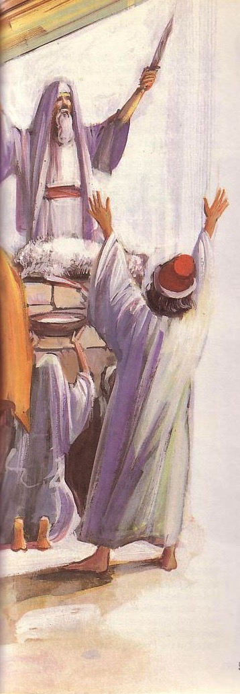
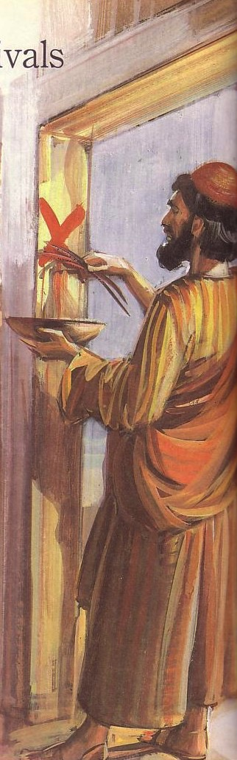
Passover's Past Significance

Slide 21
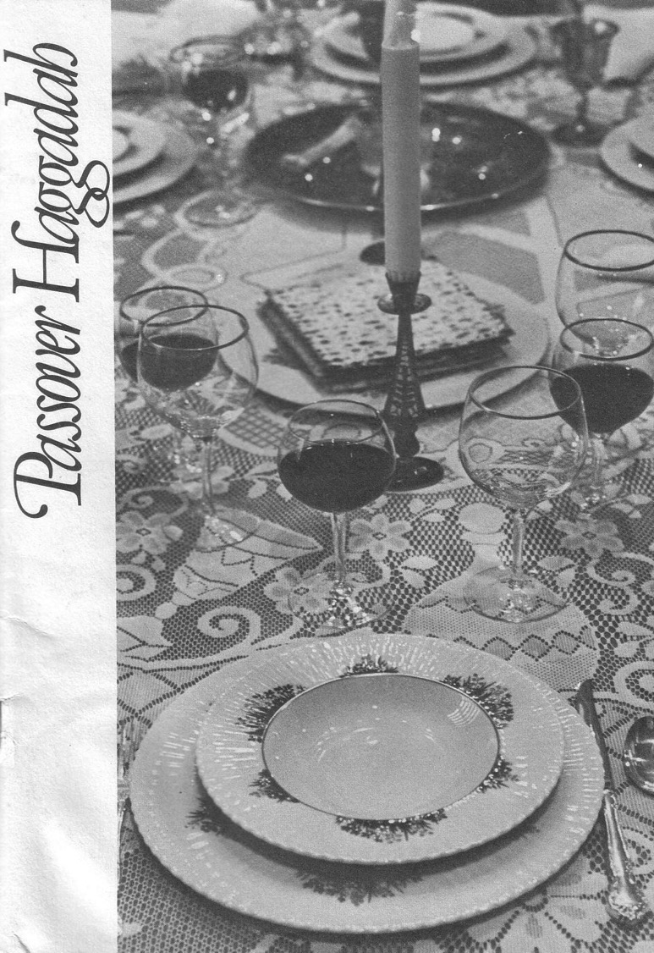
The Four Cups (Exod. 6:6-7)
Blessing
Plagues
Redemption
Praise

Slide 22
The Order of the Celebrations
Passover | Lord's Supper
Light candles | Assumed (not recorded)
1st Cup: Blessing/Sanctification, saying, “I will bring you out from under the burdens of the Egyptians” (1st of 4 “I wills” of Exod. 6:6-7) | “Take this and divide it among yourselves… I will not drink again of the fruit of the vine until the kingdom of God comes” (Luke 22:17b-18)
Washing of one's own hands | Washed disciples feet during meal (John 13:2, 4)
Parsley dipped in salt water (bitterness), middle matzah (bread) made visible and broken and 1/2 called “afikomen” (Gr. “he who comes later”) wrapped with napkin and hidden | Son of God (second member of the Trinity) made visible, broken, body wrapped, and buried in a tomb (this tradition was added to the Passover by first century AD Jewish believers)
Passover story read (Exod. 12:1-13), 4 Questions, 4 sons, 10 Plagues | Assumed (not recorded)

Slide 23
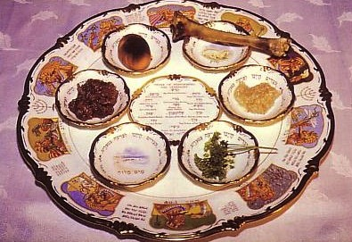
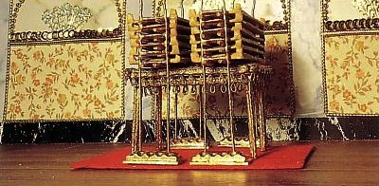
Seder Plate

Slide 24
The Order of the Celebrations
Passover | Lord's Supper
2nd Cup: Plagues/Judgment, saying, “I will rid you of their bondage”
Washing hands, eat upper and 1/2 middle matzah and bitter herbs with bottom matzah (bondage)
Passover Supper begins
Eat bitter herbs with charoseth of dates, honey, & almonds (sweetness of life with God's redemption), roasted egg (temple offerings & destruction, grief and new life), shankbone | Jesus dips the sop with Judas and Judas leaves (?)
Eat afikomen—“This is the bread of affliction…” | “This is my body…” (Luke 22:19)

Slide 25
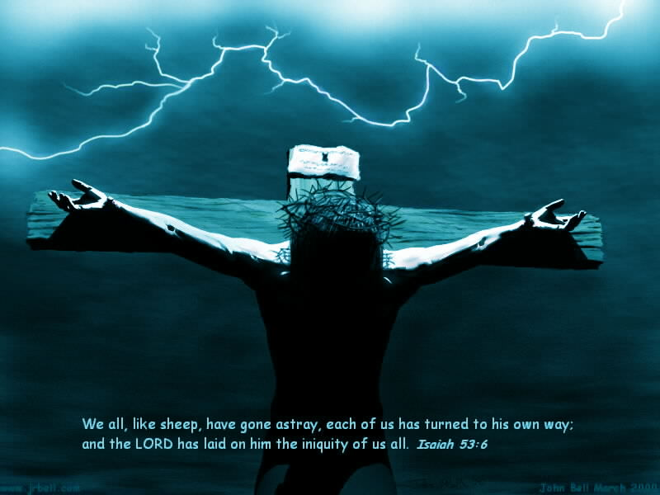
“This is my body, which is for you…”
Notes:
25

Slide 26
The Four Cups (Exod. 6:6-7)
Blessing
Plagues
Redemption
Praise

Slide 27
The Order of the Celebrations
144
Passover | Lord's Supper
3rd Cup: Redemption, saying, “I will redeem you with an outstretched arm” | “This is my blood…” (Luke 22:20) Jesus dips the sop with Judas and Judas leaves (?)
4th Cup: Praise/Regathering, saying, “I will take you to me for a people” & read Pss. 113–118 | “For as often as you eat this bread and drink this cup, you proclaim the Lord's death until he comes”
Declaration (“Next year in Jerusalem!”), hymn (Ps. 118), poem, or national anthem | Sang hymn & went to Mt. of Olives (Matt. 26:30)
Cup of Elijah: Filled but untouched; symbolizes his return before Messiah (Mal. 4:5-6; Matt. 11:13-14; 17:11-12; Rev. 11:3-12; 19:11-21), youngest child opens front door “for Elijah” | Assumed (not recorded)

Slide 28

“This cup is the new covenant in my blood” (Jer 31: 31-34)
Israel and Judah reunited (31:31-32)
Spirit indwelling (31:33)
No need for evangelism (31:34a)
Israel forgiven (31:34b)
Notes:
28

Slide 29
Black

Slide 30
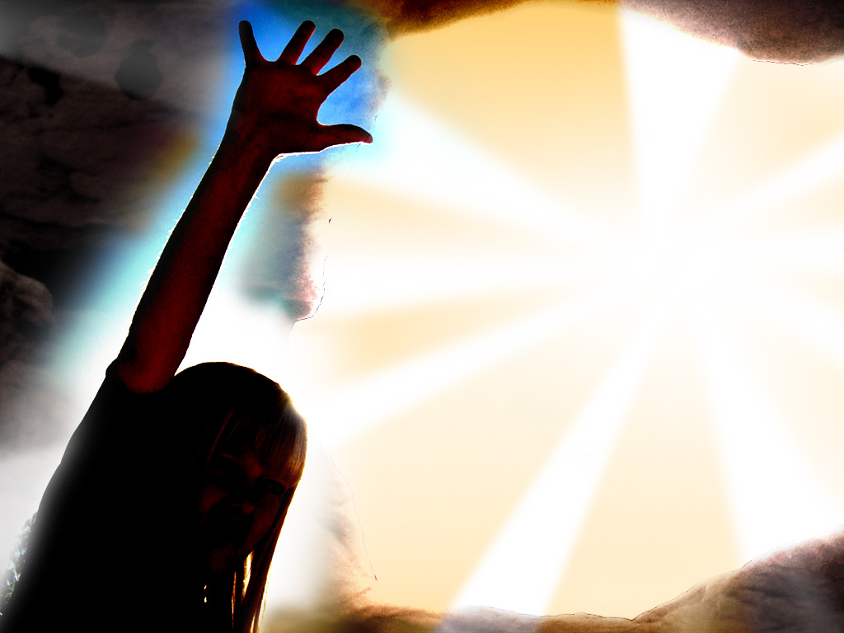
Song
“I'm not what
I wanna be,
I'm not what
I'm gonna be,
But thank God
I'm not what I was!”
Notes:
30

Slide 31
II. Look back at Christ's death for you
The Four Directions
outward
back

Slide 32
III. Look forward to Christ's return
The Four Directions
outward
back
forward

Slide 33
1 Corinthians 11:26 (NLT)
²⁶For whenever you eat this bread and drink this cup, you proclaim the Lord's death until he comes.
Notes:
33

Slide 34
The Order of the Celebrations
144
Passover | Lord's Supper
3rd Cup: Redemption, saying, “I will redeem you with an outstretched arm” | “This is my blood…” (Luke 22:20) Jesus dips the sop with Judas and Judas leaves (?)
4th Cup: Praise/Regathering, saying, “I will take you to me for a people” & read Pss. 113–118 | “For as often as you eat this bread and drink this cup, you proclaim the Lord's death until he comes”
Declaration (“Next year in Jerusalem!”), hymn (Ps. 118), poem, or national anthem | Sang hymn & went to Mt. of Olives (Matt. 26:30)
Cup of Elijah: Filled but untouched; symbolizes his return before Messiah (Mal. 4:5-6; Matt. 11:13-14; 17:11-12; Rev. 11:3-12; 19:11-21), youngest child opens front door “for Elijah” | Assumed (not recorded)

Slide 35
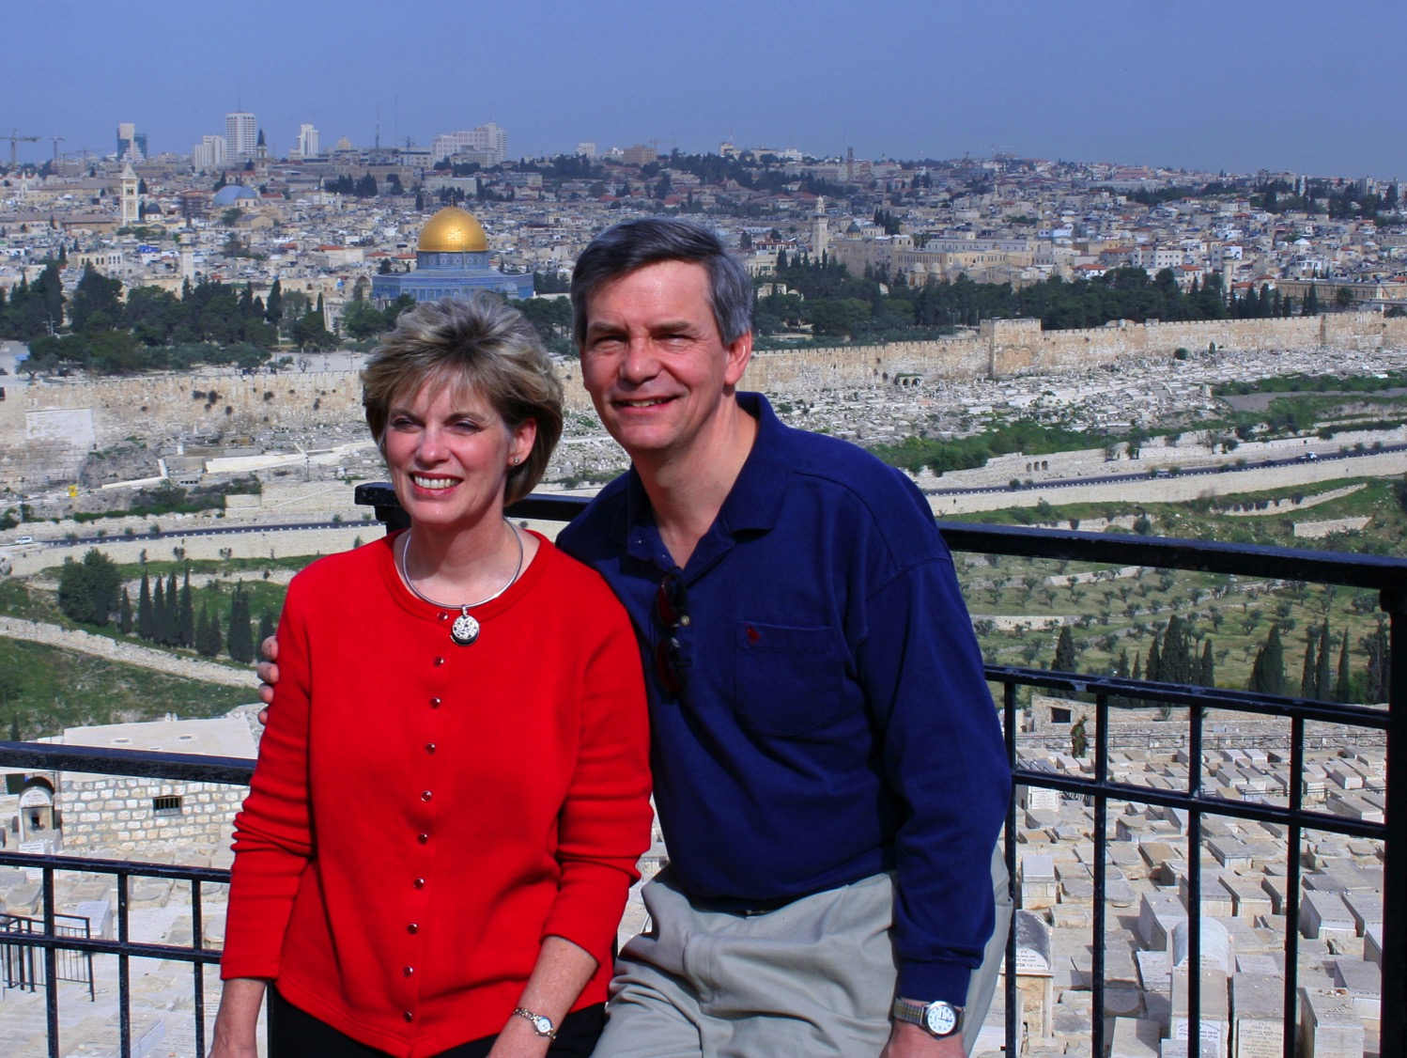
“This year we are here.
Next year in Jerusalem!”

Slide 36
III. Look forward to Christ's return
The Four Directions
outward
back
forward

Slide 37
IV. Look inward to confess all sin
The Four Directions
outward
back
forward
inward

Slide 38
1 Corinthians 11:27-29 (NLT)
²⁷Therefore, whoever eats the bread or drinks the cup of the Lord in an unworthy manner will be guilty of sinning against the body and blood of the Lord. ²⁸A man ought to examine himself before he eats of the bread and drinks of the cup. ²⁹For anyone who eats and drinks without recognizing the body of the Lord eats and drinks judgment on himself.
Notes:
38

Slide 39
1 Corinthians 11:30-32 (NLT)
³⁰ That is why many among you are weak and sick, and a number of you have fallen asleep. ³¹But if we judged ourselves, we would not come under judgment. ³²When we are judged by the Lord, we are being disciplined so that we will not be condemned with the world.
Notes:
39

Slide 40
1 Corinthians 11:33-34 (NLT)
³³So then, my brothers, when you come together to eat, wait for each other. ³⁴If anyone is hungry, he should eat at home, so that when you meet together it may not result in judgment. And when I come I will give further directions.
Notes:
40

Slide 41




Feast of Unleavened Bread
Notes:
www.stephenwilliamson.com/ Hobbies/bakin.htm (Yeast bloom)

Slide 42
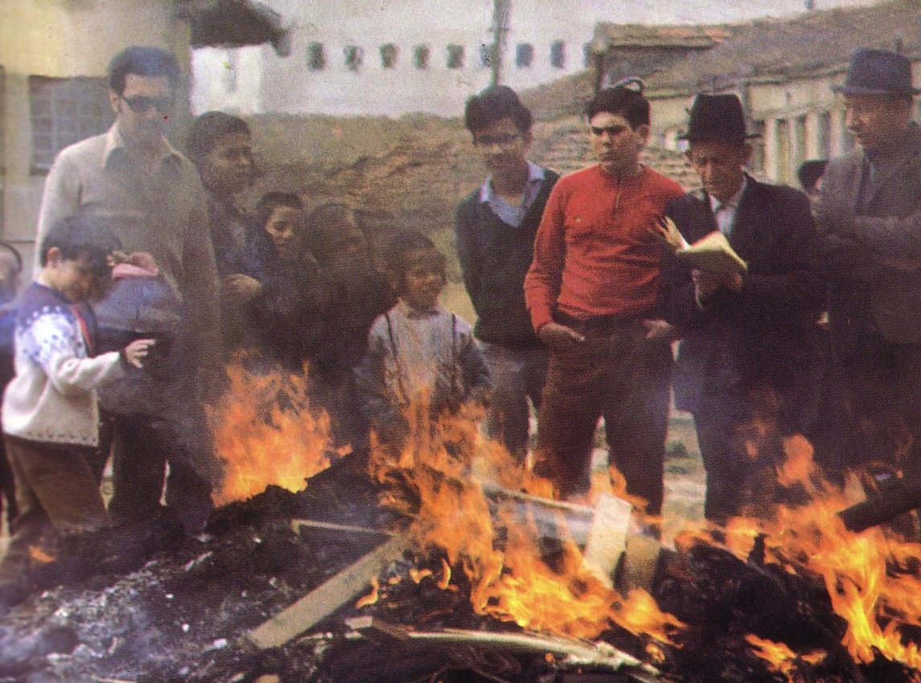
“Burn All the Yeast!”

Slide 43
Black

Slide 44
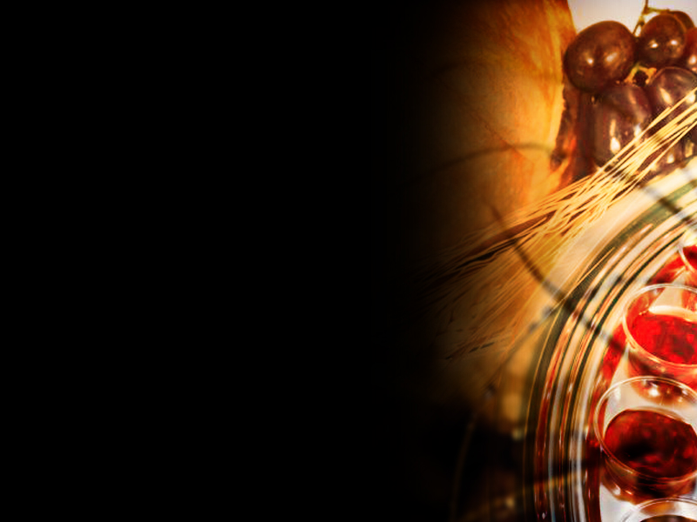
Think!
inward

Slide 45
How can you honor God in the Lord's Supper?
Notes:
45

Slide 46
Look in all four directions!
The Four Directions & Four Cups
Blessing
outward
Praise
Plagues
back
forward
inward
Redemption

Slide 47
The Four Directions
(Adapted from David Watson, I Believe in the Holy Spirit)
143
Look... | Passover (Jewish) | Lord's Supper (Christian)
Outward | Whole family involved (Exod. 12:3-4, 16) | Fellowship and unity (1 Cor. 11:17-22; 10:16-17; Luke 22:17-18)
Back | Deliverance from Egypt (Exod. 12:31-42) | Deliverance from sin (1 Cor. 11:23-25; Luke 22:20)
Forward | Wait for messianic age (Ezek. 45:21) | Anticipate return of Christ (1 Cor. 11:26; Mark 14:25; Luke 22:14-16)
Inward | Purify house of leaven or evil (Exod. 12:8, 15) | Examine sin in yourself (1 Cor. 11:27-32; cf. 5:6-8; Luke 22:19)
Blessing
Plagues
Praise
Redemption

Slide 48
“This cup is the new covenant in my blood” (Jer 31: 31-34)
Outward
Israel and Judah reunited (31:31-32)
Spirit indwelling (31:33)
No need for evangelism (31:34a)
Israel forgiven (31:34b)
Blessing
Inward
Plagues
Forward
Praise
Back
Redemption
Notes:
48

Slide 49
To properly look back on His death and look forward to His return, we need to look outward for others and look inward at our own lives.
The Main Idea
outward
back
forward
inward

Slide 50
Black

Slide 51

John 3:16

Slide 52
What outward or inward issues do you need to address right NOW?
Two Directions
outward
inward

Slide 53
Black

Slide 54


NT Preaching link at BibleStudyDownloads.org
Get this presentation and script for free!
Notes:
NT Preaching (np)

